Slide 1

Ubuntu shell project
Team 7 - Stars

Slide 2
Team members
عبدالرحمن محمد محمد الدبة
أحمد عبدالناصر شاكر محمد أبورية
خالد محمد السيد عبدالمعطي

Slide 3
Our Challenge
1- Taking the command line and sperate and parse it.
2- Execute commands with execvp() function.
3- Detecting and printing possible errors.
4- Continue taking command lines to be executed without ending the terminal : using fork() to create child process. 5- ending terminal only with exit () function.

Slide 4
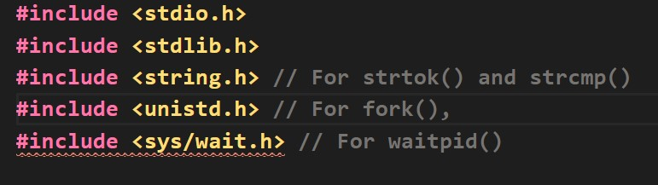
Needed libraries for our project

Slide 5
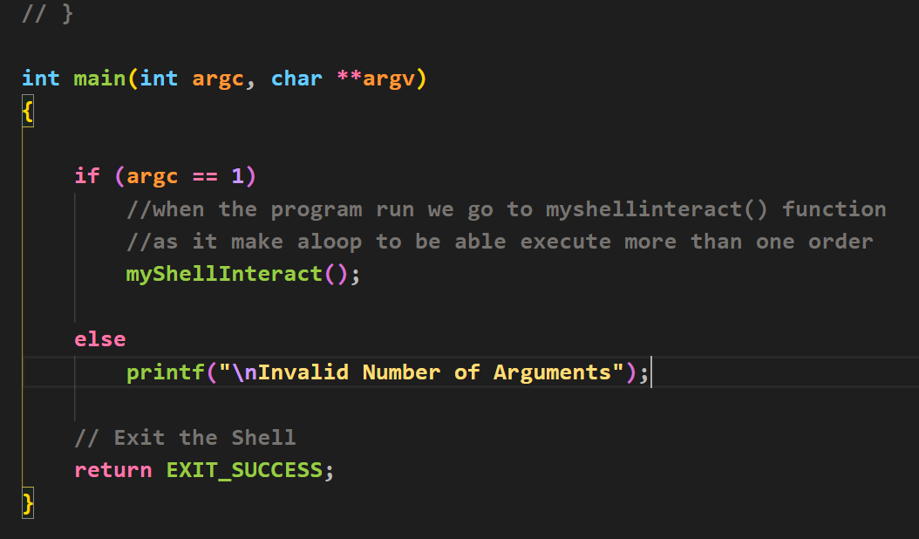
Main
when we compile our program with command gcc Myshell.c -0 out.o and run out.o file we go to myShelllInteract() function ;
as it makes a loop to execute multiple input from the user

Slide 6
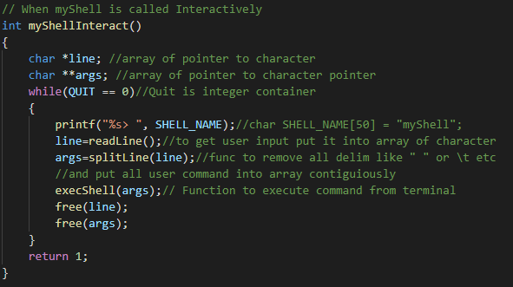
when myShell Interact() is called->
//pointer to character
----------
//pointer to pointer

Slide 7
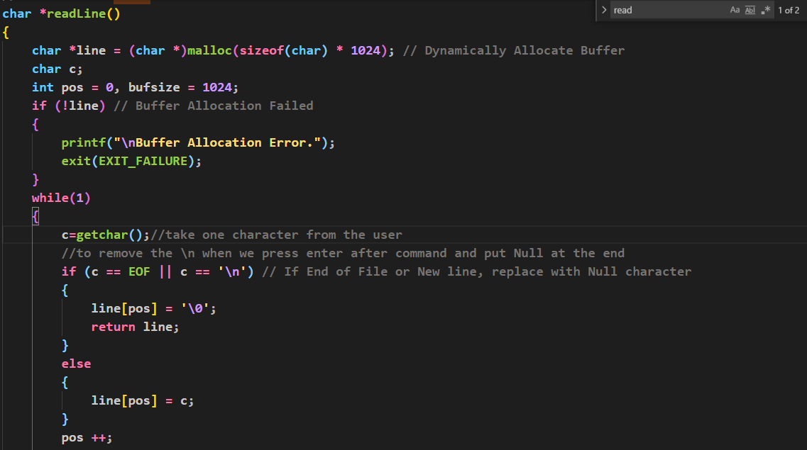
to read a line from command into the buffer
First we call readline function :

Slide 8
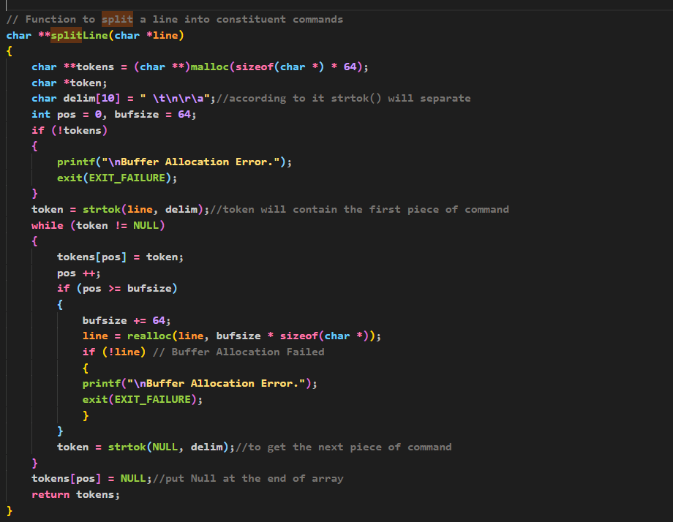
second we called spliteline() :
Which split command into a commands without any separation between them

Slide 9
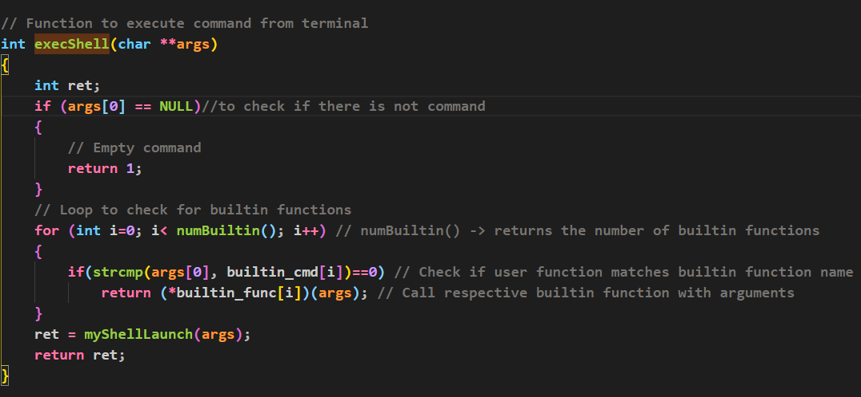
Third we call the execShell(char **args)
As it is the function responsible for execution of commands.
As first it check if the command match any built in function which are
1- change the current directory.
2-exit from our terminal. and then execute built-in function and after then it go to MyshellLanch() which make a child process with fork() and then go to
execvp() if the fork() success
execvp() ➔ to execute child process as it take two argument first is the path of file that contain some execution code and the second argument is array of characters
Plus to previous things it has built-in commands like : ls and cat.

Slide 10
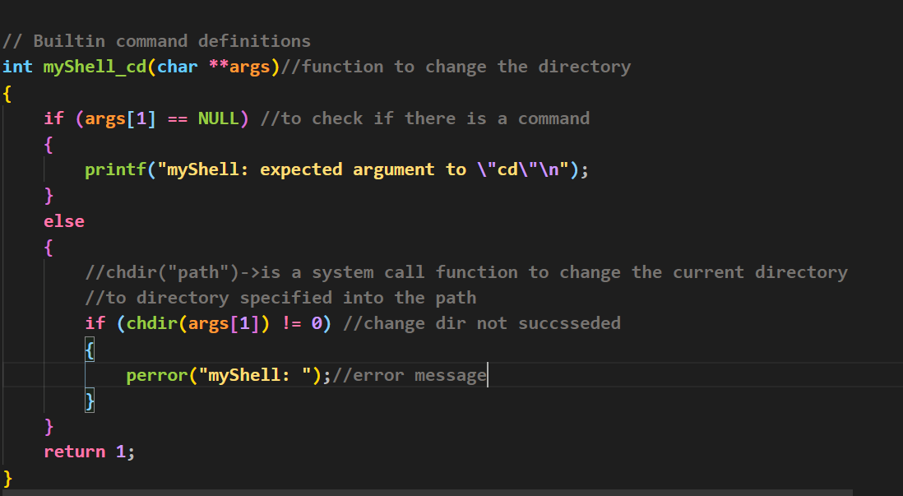
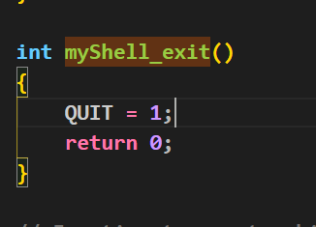
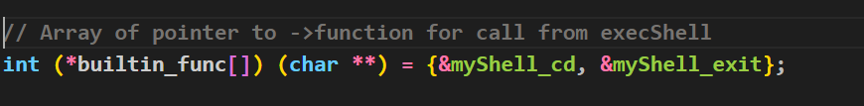
Built-in functions
Change directory built-in function →
Exit terminal built-in function→
To call built in function →

Slide 11
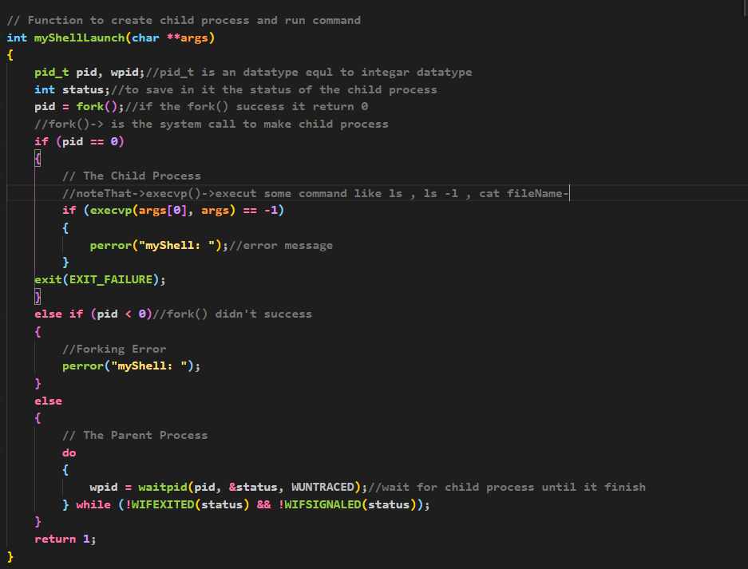
Finally we go to myShellLaunch()→to execute our command

Slide 12
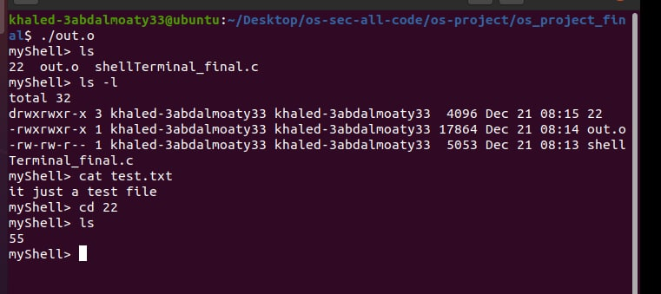
Code run
Last but not least →All of previous code is inside a while loop taking our command line then separate and execute it

Slide 13
End of Text
Thanks for your Attention ^_^

